Slide 1

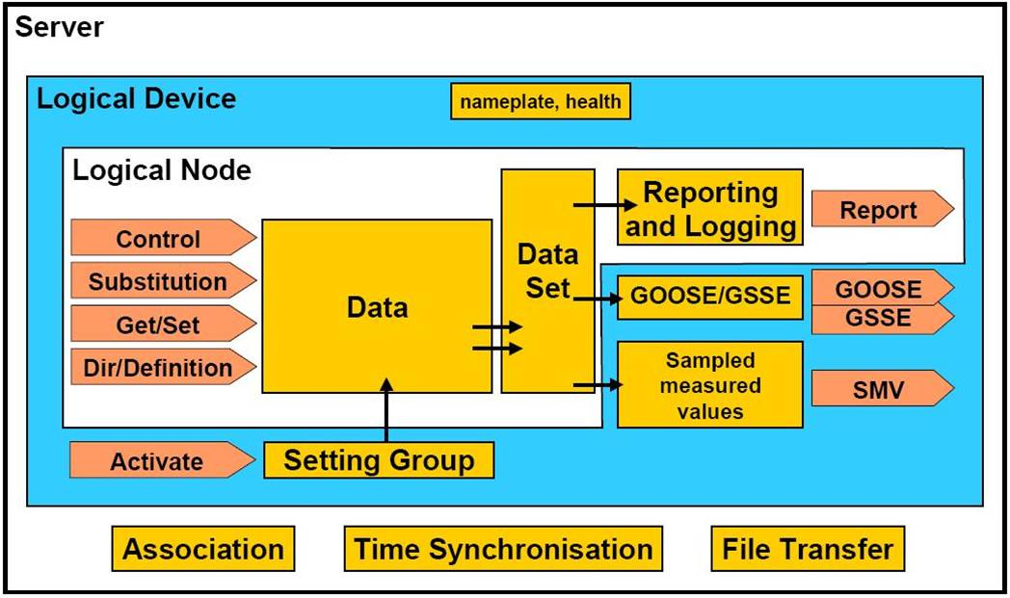
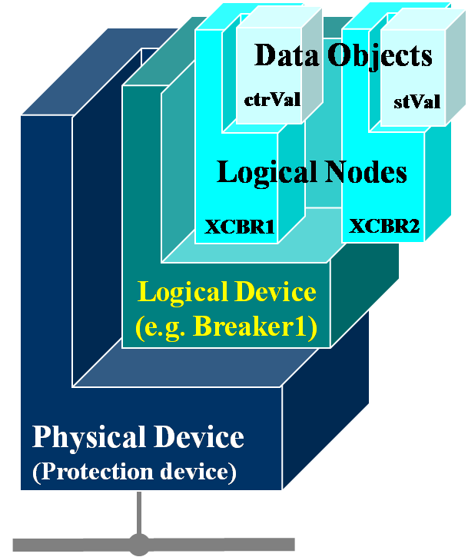
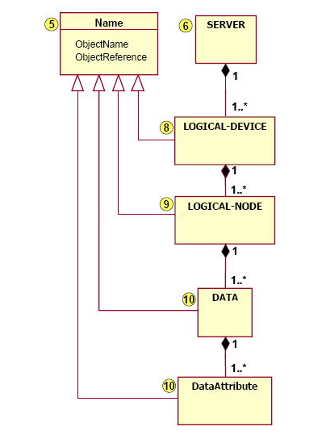
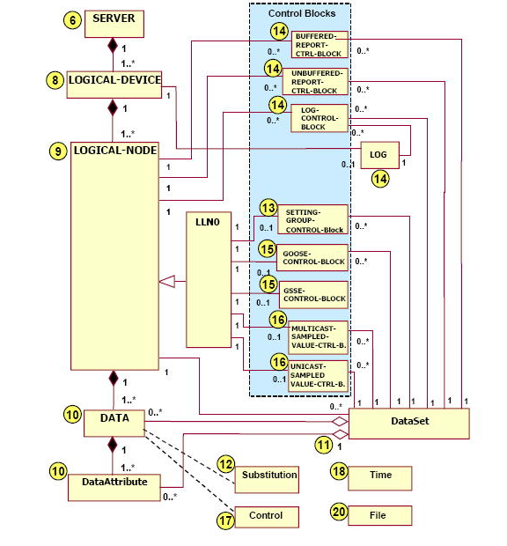
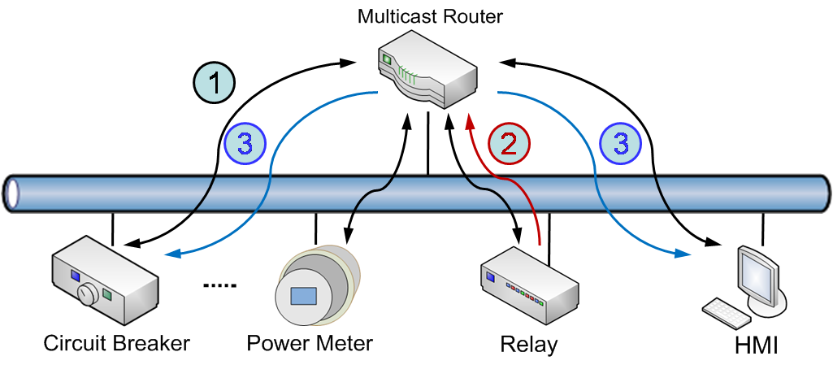
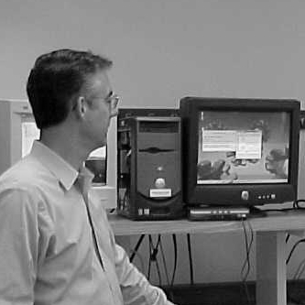

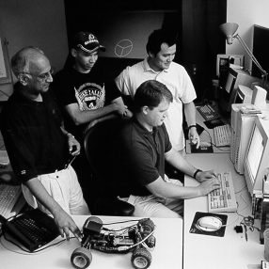
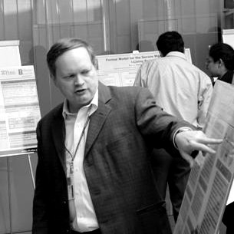

I T I S U M M E R U N D E R G R A D U A T E I N T E R N P R O G R A M, 2 0 0 7
Substation Automation
Suhas Aggarwal,IIT Guwahati
Advisor-Dr. Carl Gunter
Background
Goals
IEC 61850- Overview
INFORMATION MODEL
HIERARCHY
Develop client and server interface to
achieve interaction between service and
data models
Implement IPsec security on top of it
CONCEPTUAL SERVICE MODEL OF THE ACSI
Research Results
Use of structure arrays to build information
model hierarchy
Implementation of service functions
operating on various models
ACSI services 7-2
LogicalDeviceDirectory
GetAllDataValues
GetDataValues
SetDataValues
GetDataDefinition
GetDatasetvalues
SetDatasetvalues
CreateDataset
DeleteDataset
Modelling of report and log models
Interaction between server and client
interface via stream sockets
IPsec Secured Substation Architecture
IPSEC TUNNELS
Research Plan
To merge components of IEC 61850
with the above substation architecture and achieve a better model for substation communication
Fundamental Questions/Challenges
Related Work/Interaction with Other Projects
To study the latency challenges involved
in substation communication
Implementation of access control feature of
IEC 61850
To explore the possibilities of attacks on this
architecture
Detailed study of IEC 61850 protocol,
an international standard for substation
automation
Study and development of security hub
architecture
Information Trust Institute
University of Illinois at Urbana-Champaign
www.iti.uiuc.edu
Notes:
on

